Slide 1


Complexity Analysis of Non-Recursive (Iterative) Algorithms Session No.: 6 Course Name: Design and analysis of algorithm Course Code: R1UC407B Instructor Name: Pradeep Chauhan Duration: 50 Min. Date of Conduction of Class:

Slide 2
Review of the key concepts: Analysis of space Complexity

Slide 3
Difference between total space complexity and auxiliary space complexity. What is space complexity of recursive function.

Slide 4
Learning Outcomes:Student will be able to
Analyse time complexityof non-recursive (Iterative) algorithms

Slide 5
Session Outline
1 Introduction
2 Concept and definition
3 Activity (scenario based)
4 Reflection learning activity
5 Conclusion
6 Feedback

Slide 6
General steps for analyzing iterative algorithms: 1. Identify the number of times the loop executes. 2. Analyze the number of operations inside the loop. 3. Multiply the number of loop iterations by the number of operations per iteration. 4. Use asymptotic notation to express the result.

Slide 7
Common Iterative Complexity Cases: Constant Complexity: O(1) Single Loop: O(n) Nested Loops: O(n²), O(n³), etc. Logarithmic Complexity: O(log n) Linearithmic Complexity: O(n log n)

Slide 8
for(int i=1;i<1111;i++) { System.out.println(“hello”); } | for(int i=1;i<n;i++) { System.out.println(“hello”); } | for(int i=1;i<n;i=i+5) { System.out.println(“hello”); }
for(int i=1;i<n;i=i*2) { System.out.println(“hello”); } | for(int i=1;i*i<n;i++) { System.out.println(“hello”); } | for(int i=;i<n;i=i*i) { System.out.println(“hello”); } Multiple Variable.

Slide 9
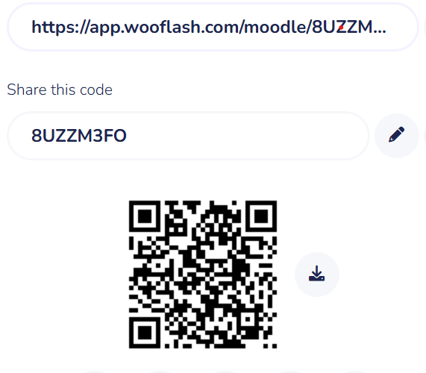
Activity-1: Think Pair Share (15 minutes)
Find time complexity of following codes:
sum(n) { int s=0; for(int i=n;i>1;i=i/2) { s=s+i; } return s; } | sum(a,b,n) { int c; for(int i=0;i<n;i=i+10) { for(int j=0;j<n;j=j*4) { c=a+b; } } }

Slide 10
Reflection- a. O(logn) b. O(n*logn)

Slide 11
Learning Outcomes:Student can now
Analyse time complexityof non-recursive (Iterative) algorithms

Slide 12
Post session activities MCQ Based Quiz on LMS.

Slide 13
In the next session, analysis of recursive algorithm will be discussed in detail.

Slide 14
Review and Reflection from students

